Slide 1
Lung Cancer Detection Using 3D Convolutional Neural Network
Group Members: (Section - 03)
Jewel Rana ------- 13101203
Anik Zaman ------- 17241023
Tanzim Islam Chowdury ----- 18141014

Slide 2
ABOUT OUR TOPIC
# Supervised Learning
# Makes Predictions
AREA COVERED
# Image Preprocessing
# Prediction of disease

Slide 3
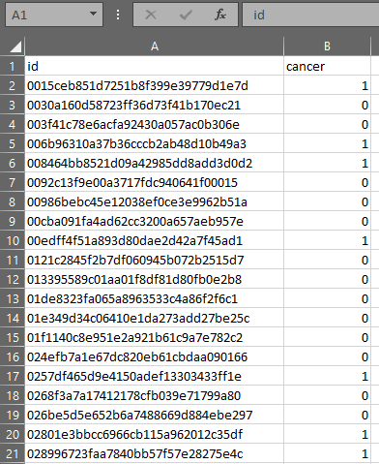
DETAILS ABOUT THE DATASET
Data consists of many 2D slices.
Input Features: CT scans of 1595 Patients, Each Patients have at least 130-270 slices
.csv file that contains the labels for this data
List of patients by their IDs and associated labels stored in that file
Output Features: Sums Up with giving predictions. Yes/No

Slide 4
EXPLANTION ABOUT THE ALGORITHM USED
Algorithm : Convolutional Neural Network , Support Vector Machine , RNN etc.
Used Algorithm:Convolutional Neural Network
Properties Of Algorithm:
Used Libraries: pycharm, tensorflow.

Slide 5
EXPLANTION ABOUT THE CODE/LIBRARY
Enough Resources In Internet.
For idea and codes: Kaggle.com
We are looking some other resources regarding this topic in the offline and also online.

Slide 6
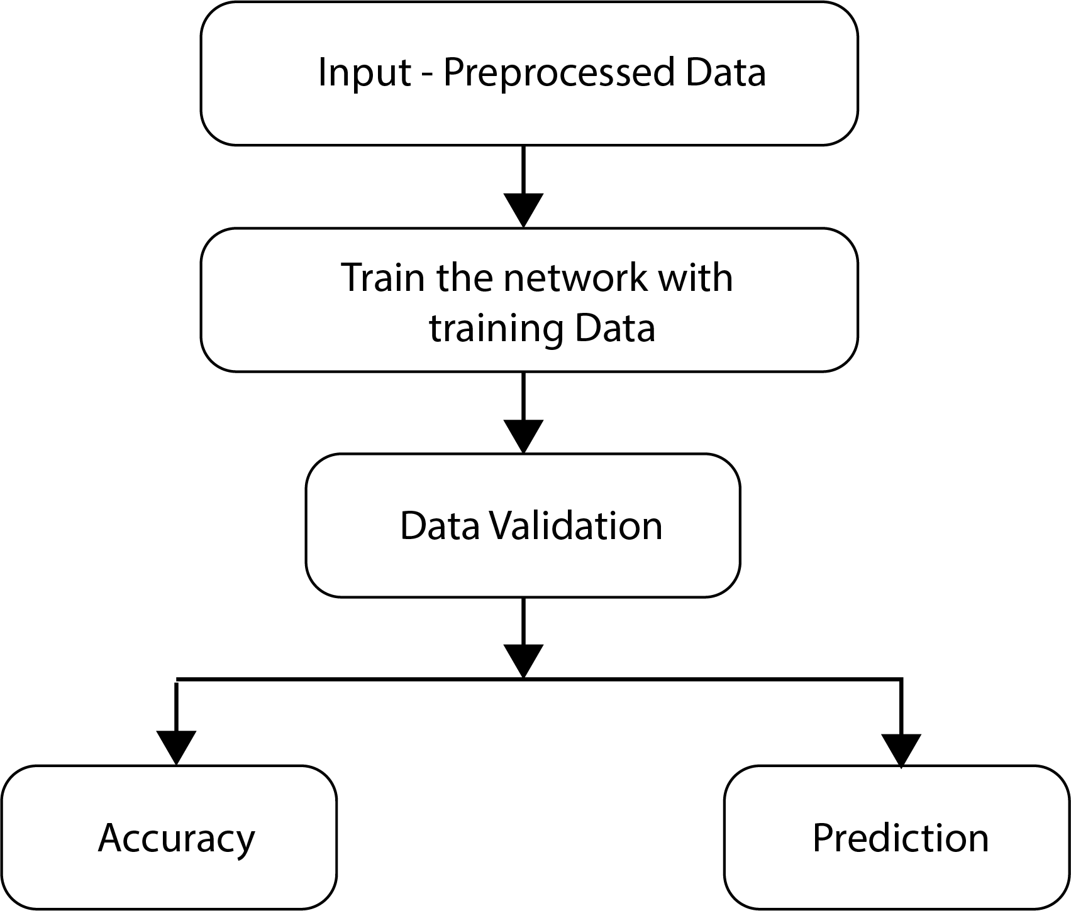
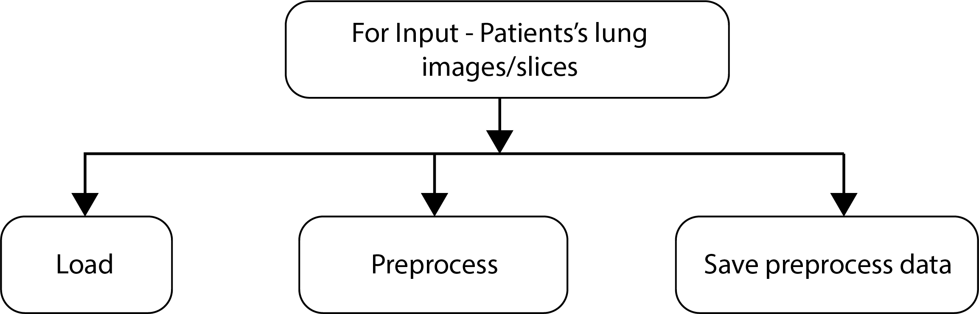
EXPANATION ABOUT OUR PROGRAM

Slide 7
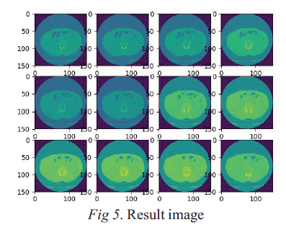
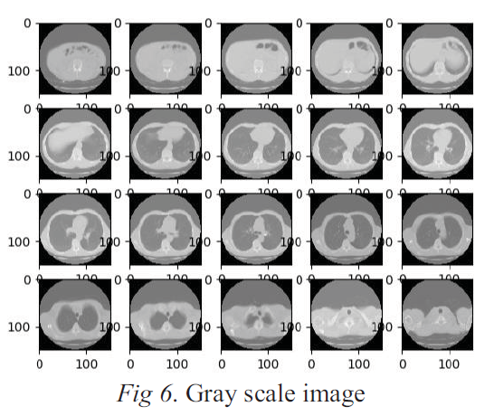
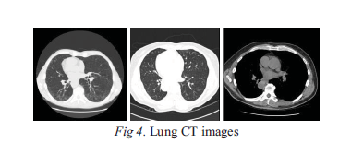
EXPERIMENT
CT lung Image Dataset
Preprocessing steps
CT Images
Digital imaging and communication using machine
Handling Data
Resizing image from 512 * 512 to 50*50
3D convolutional neural network

Slide 8
RESULTS
We can conclude that SVM has lower classification exactness than 3D convolutional neural networks in the same number of tests.
With the increasing number of tests, its preparing speed and execution are worse than 3D convolutional neural systems.
Accuracy rate 65.6%

Slide 9
CONCLUSION
We are targeting to publish paper
Our expected outcome:

Slide 10
REFERENCES
Dataset link: https://www.kaggle.com/gzuidhof/full-preprocessing-tutorial/data
The tutorials we are following:
https://pythonprogramming.net/
https://pythonprogramming.net/matplotlib-intro-tutorial/
We got the idea from some journals.

